Slide 1


WEEK 5:
Design of Binary-2-Gray code Converter using VERILOG HDL
Dıgıtal Desıgn Lab Sectıon (EEE.2003.1)

Slide 2
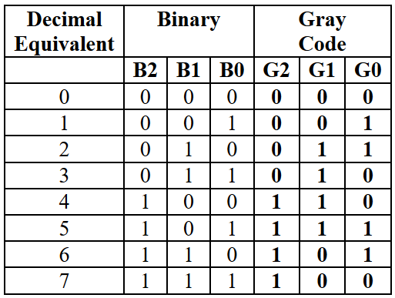
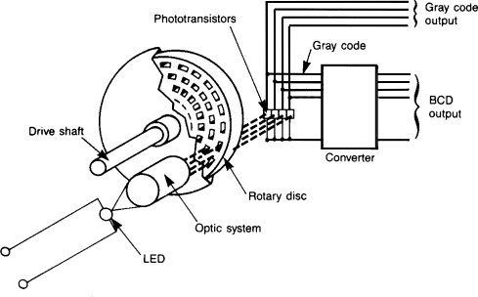
3-bit Binary-to-Gray code Converter truth table
It is a non-weighted code: not have any specific/fixed weight assigned to each symbol position in the code word.
The unique feature of Gray code is that at a time only “one” bit changes. In other words, in Gray code every new code differs from the previous in terms of “one single bit”.
Use of Gray Code: For correct measurement of angular position of the shaft.

Slide 3
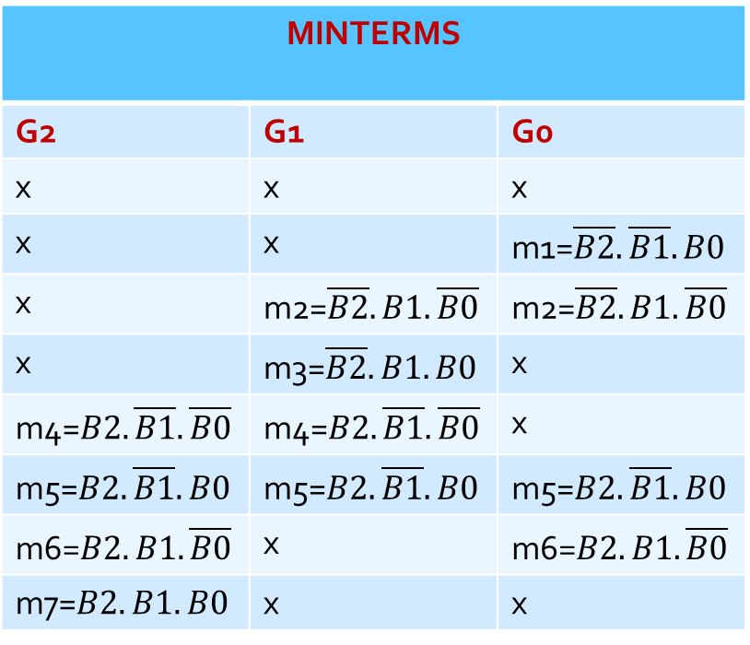
3-bit Binary-to-Gray code Converter truth table
MINTERMS
G2 | G1 | G0
x | x | x
x | x | m1=$\overline{B2}.\overline{B1}.B0$
x | m2=$\overline{B2}.B1.\overline{B0}$ | m2=$\overline{B2}.B1.\overline{B0}$
x | m3=$\overline{B2}.B1.B0$ | x
m4=$B2.\overline{B1}.\overline{B0}$ | m4=$B2.\overline{B1}.\overline{B0}$ | x
m5=$B2.\overline{B1}.B0$ | m5=$B2.\overline{B1}.B0$ | m5=$B2.\overline{B1}.B0$
m6=$B2.B1.\overline{B0}$ | x | m6=$B2.B1.\overline{B0}$
m7=$B2.B1.B0$ | x | x

Slide 4
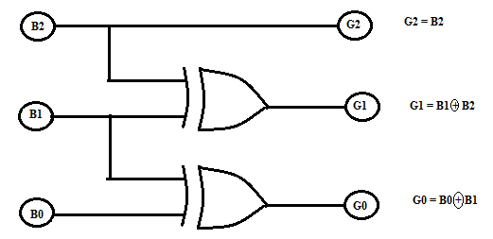
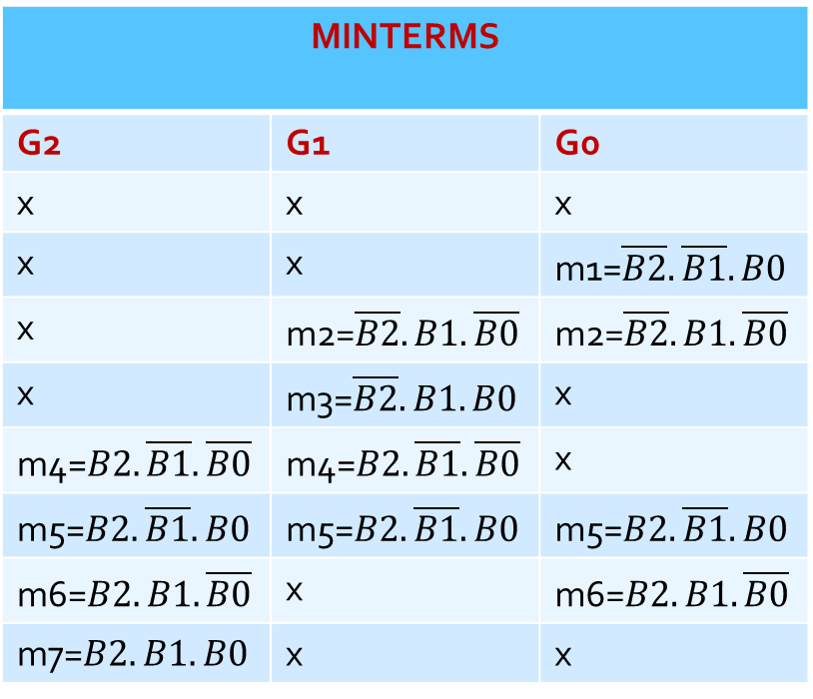



MINTERMS
G2 | G1 | G0
x | x | x
x | x | m1=$\overline{B2}.\overline{B1}.B0$
x | m2=$\overline{B2}.B1.\overline{B0}$ | m2=$\overline{B2}.B1.\overline{B0}$
x | m3=$\overline{B2}.B1.B0$ | x
m4=$B2.\overline{B1}.\overline{B0}$ | m4=$B2.\overline{B1}.\overline{B0}$ | x
m5=$B2.\overline{B1}.B0$ | m5=$B2.\overline{B1}.B0$ | m5=$B2.\overline{B1}.B0$
m6=$B2.B1.\overline{B0}$ | x | m6=$B2.B1.\overline{B0}$
m7=$B2.B1.B0$ | x | x
SIMPLIFICATIONS
G2
=m4+m5+m6+m7
=$B2.\overline{B1}.\overline{B0}$+$B2.\overline{B1}.B0$+$B2.B1.\overline{B0}$+$B2.B1.B0$
= $B2.$($\overline{B1}.\overline{B0}$+ $\overline{B1}.B0$+ $B1.\overline{B0}$+ $B1.B0$)
= $B2.\{\overline{B1}.$( $\overline{B0}$+$B0$)+ $B1.(\overline{B0}$+ $B0$)}
= $B2.\{\overline{B1}$+ $B1$}= $B2$
G1
=m2+m3+m4+m5
=$\overline{B2}.B1.\overline{B0}$+$\overline{B2}.B1.B0$+$B2.\overline{B1}.\overline{B0}$+$B2.\overline{B1}.B0$
=$\overline{B2}.$($B1.\overline{B0}$+$B1.B0$)+$B2.$($\overline{B1}.\overline{B0}$+$\overline{B1}.B0$)
=$\overline{B2}.\{B1.(\overline{B0}$+$B0$)}+$B2.\{\overline{B1}.(\overline{B0}$+$B0$)}
= $\overline{B2}.B1$+$B2.\overline{B1}$= $B2⨁$ $B1$ [XOR GATE]
G0
=m1+m2+m5+m6
=$\overline{B2}.\overline{B1}.B0$+$\overline{B2}.B1.\overline{B0}$+$B2.\overline{B1}.B0$+$B2.B1.\overline{B0}$
=$B1.$($\overline{B2}.\overline{B0}$+$B2.\overline{B0}$)+$B0.$($\overline{B2}.\overline{B1}$+ $B2.\overline{B1}$)
=$B1.\{\overline{B0}.(\overline{B2}$+$B2$)}+$B0.\{\overline{B1}.(\overline{B2}$+$B2$)}
= $B1.\overline{B0}+\overline{B1}.B0$= $B1⨁$ $B0$ [XOR GATE]

Slide 5
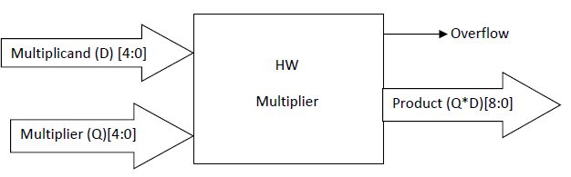


A
Laboratory Assignment #3
use Altera Quartus II software and DE-115 FPGA kit and design a hardware floating point multiplier
All numbers in this assignment are in the IEEE 754 binary floating-point format
inputs and output have 5 and 9 bits respectively
The FP format has three areas:
  the MSB represents the (S)ign of the number // 0: positive, 1:negative
  the (E)xponantial part
  the (M)antissa
For inputs:
For outputs:
The formulas are different since area sizes are not same for input and output numbers.
For the numbers at input:
For the numbers at output:

Slide 6
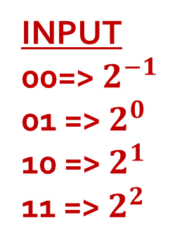

B
Laboratory Assignment #3
The FP format has three areas:
  the MSB represents the (S)ign of the number
  the (E)xponantial part
  the (M)antissa
For inputs:
For outputs:
For the numbers at input:
INPUT
00=> $2^{−1}$
01 => $2^{0}$
10 => $2^{1}$
11 => $2^{2}$
For the numbers at output:
Ex.1:
If the FP formatted number at INPUT is: 01011 =>The first-bit is sign-bit hence number is positive.
0-10-11 (S-E-M) // S=0
Exponantial area: $E=10b.⇒2^{E−1}=2^{2−1}=2$
Mantissa: $M=11b.⇒1+M∗2^{−2}=1+D\left(11b.\right)∗2^{−2}=1+3∗2^{−2}=1.75$
The number: ${(−1)}^{s}∗E∗M=+2∗1.75=3.5⇒11.1=1.11∗2^{1}⇒0−\text{10}−11$

Slide 7

C
Laboratory Assignment #3
The FP format has three areas:
  the MSB represents the (S)ign of the number
  the (E)xponantial part
  the (M)antissa
For inputs:
For outputs:
For the numbers at input:
INPUT
00=> $2^{−1}$
01 => $2^{0}$
10 => $2^{1}$
11 => $2^{2}$
For the numbers at output:
Ex.2:
If the FP formatted number at INPUT is: 11101 =>The first-bit is sign-bit hence number is negative.
1-11-01 (S-E-M) // S=1
Exponantial area: $E=11b.⇒2^{E−1}=2^{3−1}=4$
Mantissa: $M=01b.⇒1+M∗2^{−2}=1+D\left(01b.\right)∗2^{−2}=1+1∗2^{−2}=1.25$
The number:${(−1)}^{s}∗E∗M=−4∗1.25=−5$ $⇒101=1.01∗2^{2}⇒1−\text{11}−01$

Slide 8
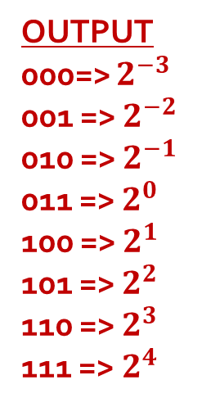
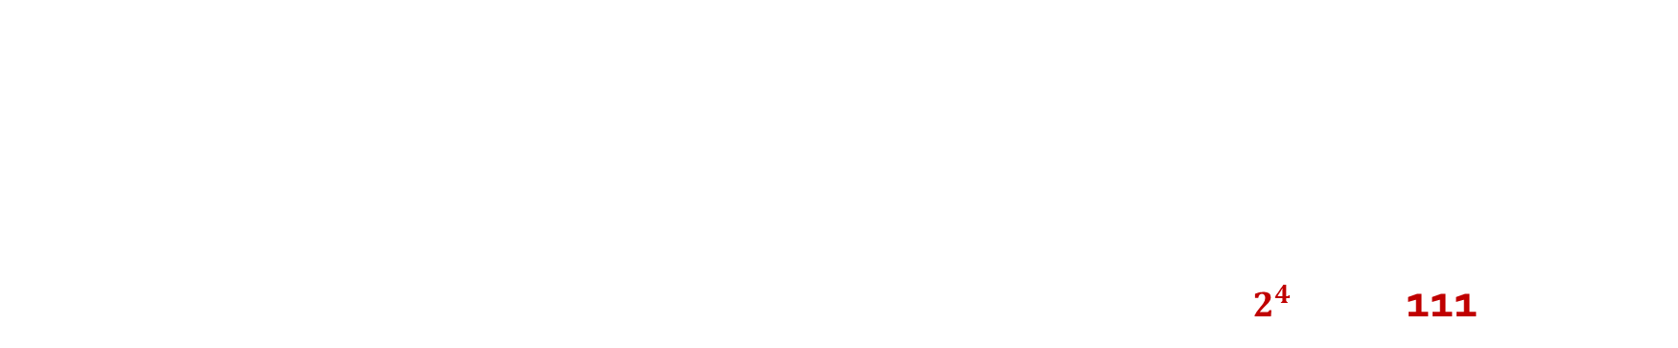
D
Laboratory Assignment #3
The FP format has three areas:
  the MSB represents the (S)ign of the number
  the (E)xponantial part
  the (M)antissa
For inputs:
For outputs:
For the numbers at input:
OUTPUT
000=> $2^{−3}$
001 => $2^{−2}$
010 => $2^{−1}$
011 => $2^{0}$
100 => $2^{1}$
101 => $2^{2}$
110 => $2^{3}$
111 => $2^{4}$
For the numbers at output:
Ex.3:
If the FP formatted number at OUTPUT is: 111100011 =>negative. 1-111-00011 (S-E-M) // S=1
Exponantial area: $E=111b.⇒2^{E−3}=2^{7−3}=16$
Mantissa: $M=00011b.⇒1+M∗2^{−5}=1+D\left(00011b.\right)∗2^{−5}=1+3∗2^{−5}=\text{1.09375}$
The number:${(−1)}^{s}∗E∗M=−16∗\text{1.09375}=−17.5$ $⇒10001.1=1.00011∗2^{4}⇒1−\text{11}\text{1}−000011$
Now is correct.

Slide 9
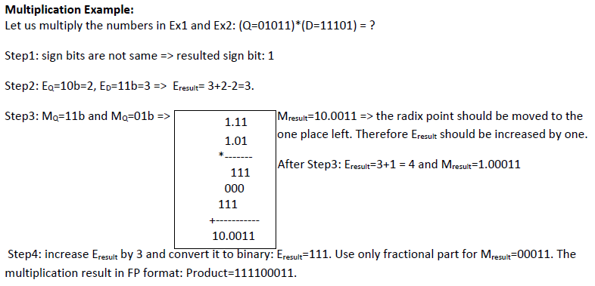
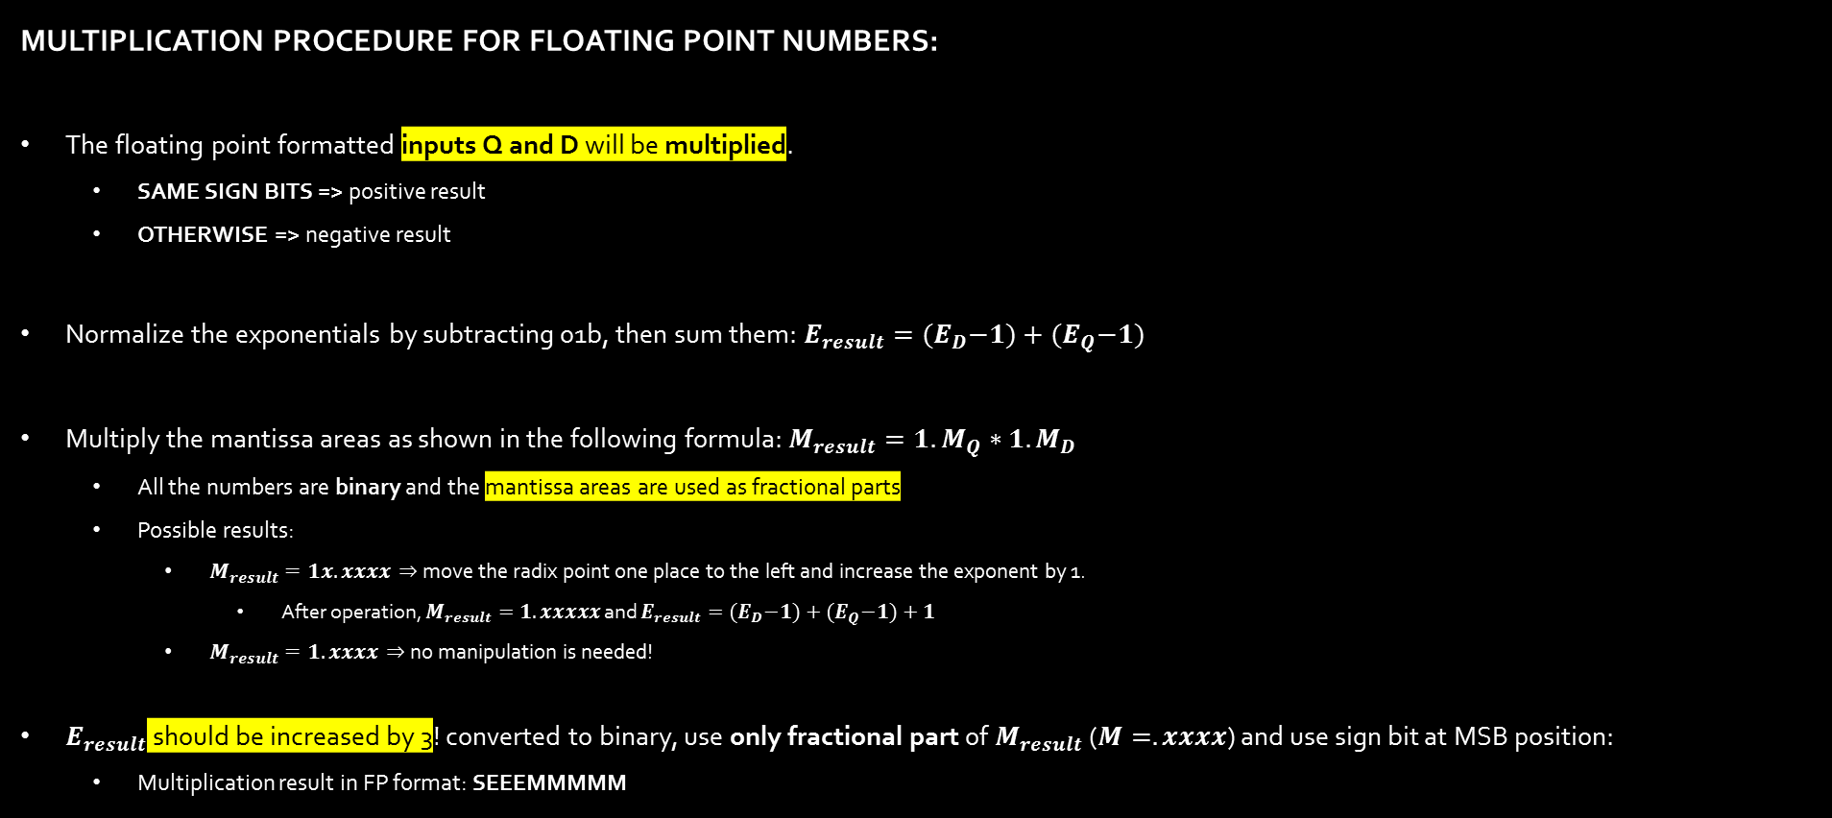
Laboratory Assignment #3
MULTIPLICATION PROCEDURE FOR FLOATING POINT NUMBERS:
The floating point formatted inputs Q and D will be multiplied.
  SAME SIGN BITS => positive result
  OTHERWISE => negative result
Normalize the exponentials by subtracting 01b, then sum them: $E_{result}={(E}_{D}−1)+{(E}_{Q}−1)$
Multiply the mantissa areas as shown in the following formula: $M_{result}={1.M}_{Q}∗{1.M}_{D}$
  All the numbers are binary and the mantissa areas are used as fractional parts
  Possible results:
    $M_{result}=1x.xxxx⇒$ move the radix point one place to the left and increase the exponent by 1.
      After operation, $M_{result}=1.xxxxx$ and $E_{result}={(E}_{D}−1)+{(E}_{Q}−1)+1$
    $M_{result}=1.xxxx⇒$ no manipulation is needed!
$E_{result}$ should be increased by 3! converted to binary, use only fractional part of $M_{result}$ ($M=.xxxx$) and use sign bit at MSB position:
  Multiplication result in FP format: SEEEMMMMM

Slide 10

Thank You!
salih.colakoglu@marmara.edu.tr

